Slide 1
NIHR Global Health Group Dementia Care & Prevention (DePEC)
Dr Susan Hrisos
On behalf of
Professor Dame Louise Robinson & the DePEC team

Slide 2
DePEC: ambitions
1. Develop new connections between UK centres of dementia excellence, existing LMIC networks and new LMICs
2. Identify priority areas for public health/dementia care research
3. Establish the foundation for a translational research programme on dementia risk reduction and enhanced care and
4. Create the partnerships and capacity for a future NIHR DePEC Global Health Research Unit.

Slide 3
DePEC outputs
1. Consensus (academic, stakeholder and policy maker) strategies to reduce future dementia risk including a brain health initiative plan to inform government strategies
2. Evidence-based, novel approaches to identify those at risk of, or with, dementia to reduce future burden of disease in the population
3. Recommendations for efficient, feasible dementia care pathways
4. Innovative, practical methods for training generalist workforces and supporting family carers

Slide 4
Objective 1: Workstream1 month 1-6
Create a new Global Research Group on dementia risk reduction and improved post-diagnostic care
Map existing dementia research and care in our partner LMICs.
Objective 2: WS2 m1- 20
Develop simple tools to identify people at high risk of developing dementia and those with undetected dementia.
Objective 3: WS3 m 15-36
Establish dementia risk reduction research in LMICs by setting up and piloting an intervention to reduce dementia risk.
Objective 4: WS4 m 9- 36
Determine efficient/feasible dementia care models for LMICs (workforce).
Objective 5: WS5 m 7-36
Develop an impact strategy for each partner LMIC, including research priorities, service organisation and workforce development,
Creation of a future NIHR Global Research Unit.

Slide 5
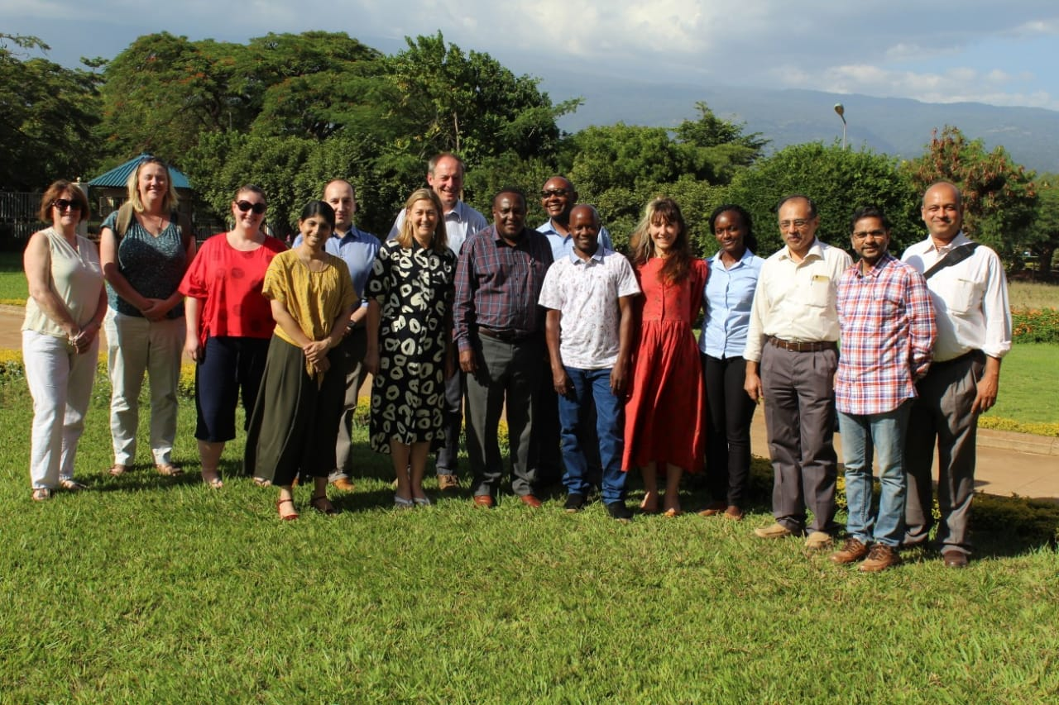
Work so far: WS1
Leads: Louise Robinson, Blossom Stephan, Michaela Goodson (Malaysia)
Global Health Research Group
Now well established
dementia risk reduction
improved post-diagnostic care
Partners from Malaysia India, Tanzania & UK
Notes:
Methods: Workshops and facilitated groups
UK introductory workshop with all partners
Facilitated task groups: partner countries will present data on
population trends in dementia;
current care pathways
dementia research to date (public health and risk factors)
Outcomes:
Identify priority areas for i) research and ii) care/service development
Review and agree tasks and milestones.

Slide 6
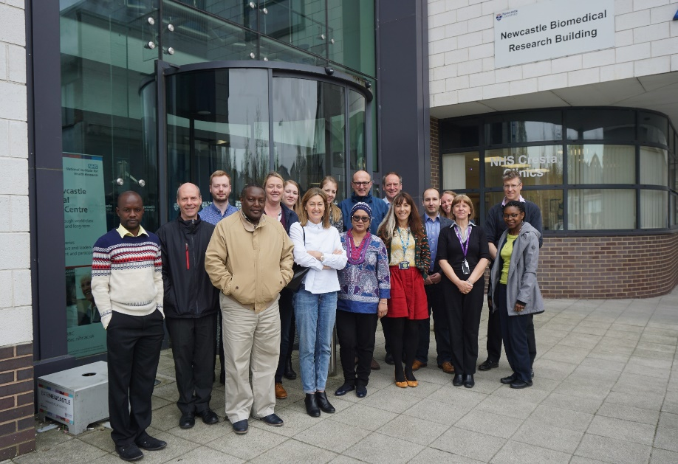
Work so far: WS1
Leads: Louise Robinson, Blossom Stephan, Michaela Goodson (Malaysia)
Co-development
Country ‘narratives’
outlining current research, practice & priorities for each partner
Capacity building
Development of a MOOC:
‘Dementia Care: Living Well as Dementia Progresses’
Available on Futurelearn
Financial Assistance Funding & Training:
Joint funding application May 2019
Workshop DePEC Leads meeting, Oct ‘19

Slide 7
Work so far: WS2.1
Dementia Risk Prediction Model Development and Validation
Objective: Develop tools for predicting future dementia applicable to LMICs
Leads: Blossom Stephan, Matthew Prina and Devi Mohan
Statistical Lead: Eduwin Pakpahan
Systematic reviews of the prevalence of mild cognitive impairment (MCI) in LMICs and risk of progression from MCI to dementia in LMICs.
Dementia risk prediction models - published (Neurodegenerative Disease Management, 2017)
MCI operationalization and prevalence in LMIC - manuscript being prepared for publication
A review of cognitive assessment tools used in LMICs.
Systematic review & meta-analysis - published (International Psychogeriatrics, 2017)
Dementia risk prediction model analysis using 0/66 Study data.
manuscript being prepared for publication
External model validation using data from LMICs.
3 datasets already obtained and analysis underway
Notes:
The overall objective of WS2 is to develop simple tools to identify people at high risk of developing dementia and those with undetected dementia:
Current status for WS2.1
Update systematic review of dementia risk prediction models
Published (Neurodegenerative Disease Management, 2017)
Undertake dementia risk prediction model analysis – 10/66 Study data
Manuscript being prepared for publication
Undertake external model validation using data from LMICs
3 datasets already obtained and analysis to begin April 2019
Undertake systematic review of MCI operationalization and prevalence in LMIC
Manuscript being prepared for publication
Review protocol on risk of progression to dementia from MCI in LMICs has been registered (April 2019). Preliminary search identified approximately n=10,000 articles

Slide 8
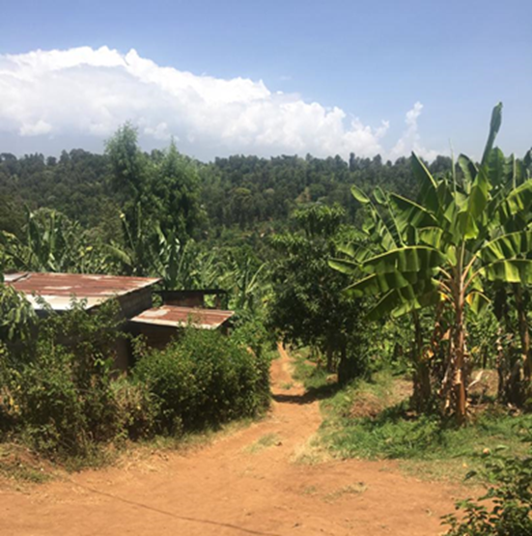
Work so far: WS2.2
Dementia screening/case-finding App development
Objective: Develop tools to identify undetected dementia cases in LMICs
Leads Richard Walker, Catherine Dotchin, Keith Gray, Stella Paddick
A prototype dementia screening App for use in LMICs has been developed to help identify:
people at high risk of developing dementia
people with undetected dementia
IDEA cognitive screen
six items 4 taken from CSI-D, CERAD 10 word list, praxis task
Validated in Tanzania, Nigeria, Malaysia, Zambia
IDEA-IADL questionnaire – three Qs
Delirium rule out
Notes:
Aims: To develop a dementia screening/case-finding App suitable for use :
1. In low-middle income country settings
2. By non-specialist health workers
3. In illiterate/low literate as well as higher literacy groups (common challenges in LMICs)
Incorporate decision support (onward referral, advice)
Challenges of screening in LMIC countries:
Few specialist clinicians
Screening tools therefore need to be as accurate and brief as possible (more than HICs)
If not accurate or too complex – primary care workers won’t use them (remember task shifting involves all other health areas)
How do we arrange safe referral pathways – can’t refer everyone/need to avoid treatable false positives
Overall aim: To design a dementia screening app and decision support aid for non-specialists to use in LMIC settings. (validating in different clinical areas)
Initial development in Tanzania, but designed as toolkit for dementia case-finding adaptable to other LMIC settings following further (efficient and resource conscious) validation.

Slide 9
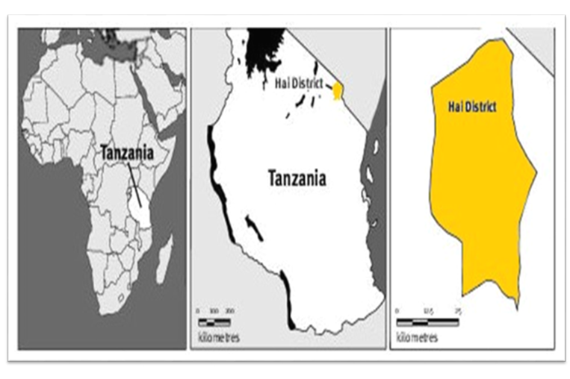
Work so far: WS2.2
Dementia screening/case-finding App development
Objective: Develop tools to identify undetected dementia cases in LMICs
Leads Richard Walker, Catherine Dotchin, Keith Gray, Stella Paddick
Validation study - Hai DSS, Tanzania
>3,000 adults (60 years +) screened in Tanzania using the App
2nd stage blind clinical assessment for consensus DM diagnosis underway
Two stage dementia prevalence study conducted in India
blind screen and assessment of 140 consecutive sample patients underway
Notes:
Aims: To develop a dementia screening/case-finding App suitable for use :
1. In low-middle income country settings
2. By non-specialist health workers
3. In illiterate/low literate as well as higher literacy groups (common challenges in LMICs)
Incorporate decision support (onward referral, advice)
Challenges of screening in LMIC countries:
Few specialist clinicians
Screening tools therefore need to be as accurate and brief as possible (more than HICs)
If not accurate or too complex – primary care workers won’t use them (remember task shifting involves all other health areas)
How do we arrange safe referral pathways – can’t refer everyone/need to avoid treatable false positives
Overall aim: To design a dementia screening app and decision support aid for non-specialists to use in LMIC settings. (validating in different clinical areas)
Initial development in Tanzania, but designed as toolkit for dementia case-finding adaptable to other LMIC settings following further (efficient and resource conscious) validation.
Prototype developed using Open Data Kit (ODK) software
For use on Android-based tablets
In Tanzania has been combined with a census in 12 villages with screening done by census enumerator
(Aim- understand difference between those who do and do not present for screening – comparing to previous validation studies).

Slide 10
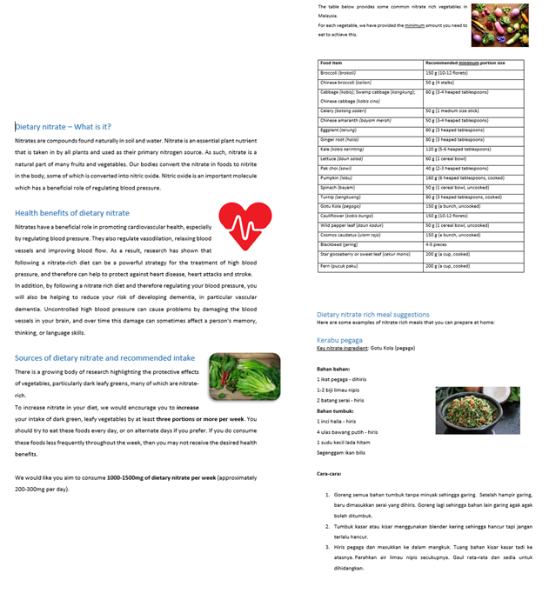
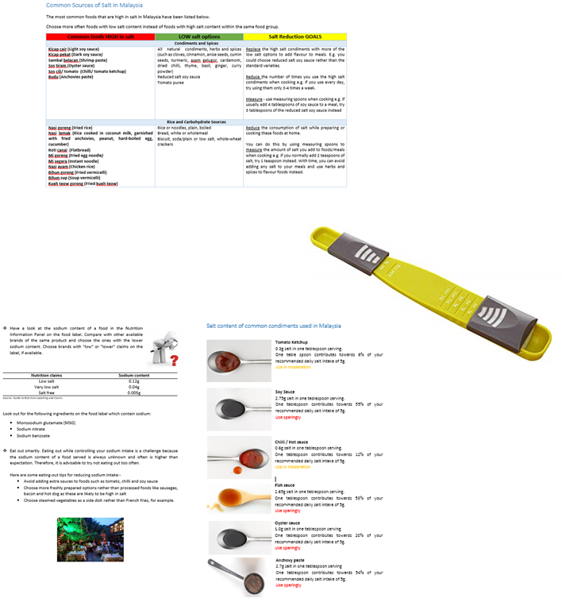
Work so far: WS3
Pilot Nutritional Intervention for Prevention of Cognitive Decline in Malaysia
Objective: Feasibility trial of a multi-domain dietary intervention to increase consumption of nitrate-rich green leafy vegetables & to reduce salt intake
Leads: Mario Siervo, Keith Gray, Profs Reidpath and Chaiyakunapruk (Monash)
RA: Andrea McGrattan
24-week evaluation period involving 120 Malaysian adults with raised blood pressure (50 to 75 years)
randomised 2*2 factorial trial including four parallel arms:
(1) control
(2) high-nitrate vegetable consumption
(3) low salt consumption
(4) combined high-nitrate vegetable + low salt consumption
Participants recruited from SEACO cohort (30 per arm)
Results will inform a follow-on efficacy trial
Notes:
Study objective
This is a feasibility and acceptability trial to determine the potential to deliver a 24-week dietary intervention to effect changes in consumption in high-nitrate green leafy vegetables and salt.
Outcome measures
Feasibility of the intervention evaluated by:
-Participant recruitment and retention on the trial
-Appropriateness and validity of data collection processes and secondary outcome measures
-Acceptability of intervention by different ethnic group and during different cultural and religious observances
-Adherence to the intervention evaluated with self-reported (dietary questionnaires) and objective biomarkers (urinary nitrate and salt excretion).
-Resource capacity for the management of the intervention – identify the direction and magnitude of mismatch in resource expectation and resource capacity
Cognitive tests chosen based on feasibility of administration by SEACO team
Primary Outcome
Feasibility (recruitment & retention, acceptability of, and adherence to intervention, appropriateness of data collection measures and resource capacity)
Secondary Outcomes
Cognitive test performance
Resting blood pressure
Body composition: height, weight, waist circumference, body fat
Physical performance: hand-grip strength, gait speed and timed up and go, PASE scale
Mood: Geriatric Depression Scale
Behaviour change: adherence to nutritional interventions measured by dietary methods (multiple-pass 24-hr recall / FFQ) and urinary biomarkers (24-hr sodium and nitrate excretion). Saliva samples and salivary strips will measure changes in nitrite concentrations during the intervention
Plasma biochemical outcomes: biomarkers of cardio-vascular risk (C-reactive protein, glycated haemoglobin, nitro-tyrosine) and direct brain measures such as plasma BDNF, plasma amyloid β42 and amyloid β40

Slide 11
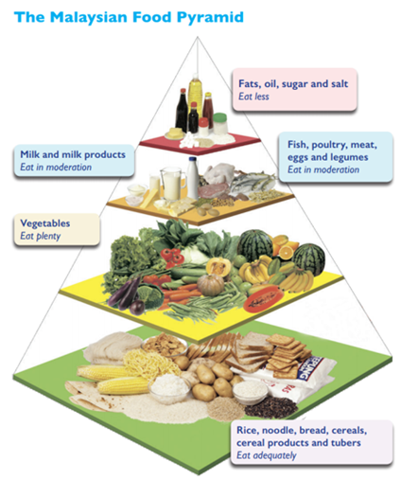
Work so far: WS3
Pilot Nutritional Intervention for Prevention of Cognitive Decline in Malaysia
Objective: Feasibility trial of a multi-domain dietary intervention to increase consumption of nitrate-rich green leafy vegetables & to reduce salt intake
Leads: Mario Siervo, Keith Gray, Profs Reidpath and Chaiyakunapruk (Monash)
RA: Andrea McGrattan
Ethical approval granted by MONASH university
currently awaiting MREC approval
Review of intervention materials by Malaysian dietitian
Capacity building:
Training / workshops with research staff in SEACO before baseline assessments
Laboratory analysis conducted in SEACO and MS to provide training

Slide 12
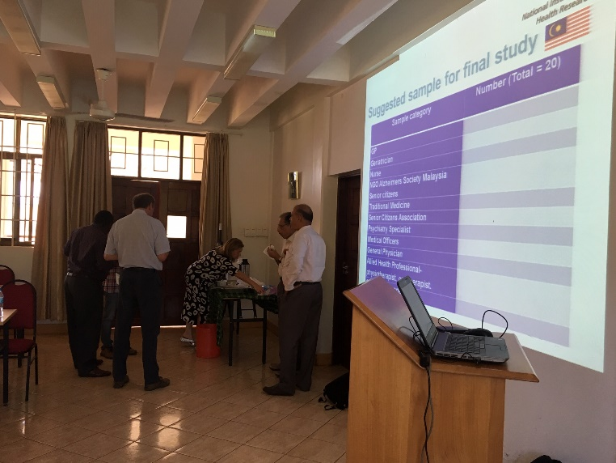
Work so far: WS4
Post-diagnostic dementia care: efficient & sustainable models Objectives: Co-develop DM care pathways & build workforce to deliver future DM care
Leads: Louise Robinson, Lynne Corner, Michaela Goodson, Thomas Iype (India)
SRA/RAs: Susan Hrisos, Heather Yemm, Emma McLellan
Qualitative study
Semi-structured interviews & focus groups
2 respondent groups: ‘Care Providers & Facilitators’ and ‘Users of care & support services’
Analysis led by UK research team, involving partner researchers
Literature & scoping reviews
Models of best practice & care processes
Existing dementia training resources
Capacity building:
Workshops/ Webinars: Best practice in research governance & ethics, Qualitative research, Nvivo.
Notes:
Dementia care pathways
Map current healthcare pathway for PwD in each country
Explore nature & availability of social support
Co-produce dementia care guidelines for each country
Build workforce capacity
Explore dementia care workforce in each country
Explore availability & accessibility of dementia training
Co-develop capacity-building resources & library
Interviews to explore:
Participants’ understanding of DM & views on dementia care in their country, including social support
Help-seeking behaviours of PwD and their families/carers
Current DM workforce & extent and availability of DM training
‘Care Providers & Facilitators’
Healthcare professionals
Policy makers & commissioners
Local government health officials
Hospital/clinic managers
Traditional medicine practitioners
Faith healers/ Shamans
Community leaders
NGOs
‘Users of care & support services’
Unpaid family and friend carers
People with early-stage dementia
Up to 20 Care providers & facilitators from each country
Approximately equal number (2-4) of provider types
If feasible, up to 20 Users of care & support services
Topic guide
Explores understanding of & perspectives on:
Dementia
The dementia care pathway in their country
General healthcare provision for older people
Factors that influence or affect care for PwD
Priority areas to improve the situation for PwD
Experience, availability & relevance of DM training
Professionals & PwD/family carers

Slide 13
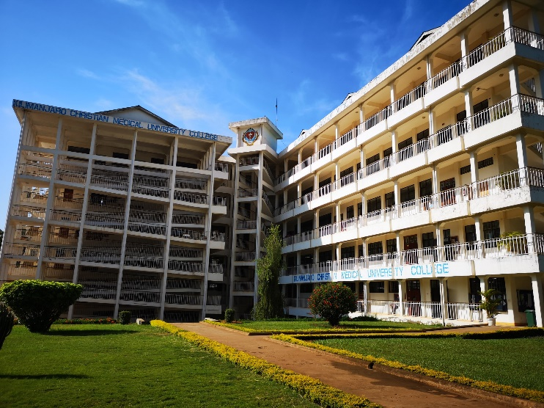
Work so far: WS4
Post-diagnostic dementia care: efficient & sustainable models Objectives: Co-develop DM care pathways & build workforce to deliver future DM care
Leads: Louise Robinson, Lynne Corner, Michaela Goodson, Thomas Iype (India)
SRA/RAs: Susan Hrisos, Heather Yemm, Emma McLellan
Qualitative study
Malaysia: data collection & analysis underway
Tanzania: ethics in progress
India: planning visit 23-29th July 2019
Literature & scoping reviews
underway
Capacity building:
all resources developed or sourced will be made available on DePEC website.
In person training delivered during programme meetings and site visits

Slide 14
NIHR Global Health Group Dementia Care & Prevention (DePEC)
Dr Susan Hrisos
On behalf of
Professor Dame Louise Robinson & the DePEC team

